Slide 1
The Impact of Pandemic Covid-19 to Exchange Rate OF Rupiah to other currencies
Samingun Handoyo - 0880810
Andreas Rony Wijaya (安德里) - 0852623

Slide 2
Background
Covid-19 has had an impact in various fields of human life, such as social, education, industry, government, and socio-economy, etc
In the economic sector, the exchange rate is an indicator of the economic stability of a country
The government has a policy to control the exchange rate
The government is also making efforts to control Covid-19
In fact, many countries have not succeeded in dealing with Covid-19.
Is the exchange rate of a country affected by the addition of positive cases of Covid-19?

Slide 3
Background
Prediction of future exchange rates is important in policy making.
How to predict exchange rates using the VAR, CNN, and LSTM methods?
In the time series, the vector autoregressive method is used for forecasting multiple time series data.
whereas in machine learning, CNN and LSTM have characteristics similar to VAR

Slide 4
Goal
Knowing the effect of the number of daily positive confirmed cases on the exchange rate
Modeling the exchange rate of the rupiah against several countries' currency values ​​that have a similar case to Indonesia
Determine the best model
Predicting the exchange rate of the IDR against the currencies of several countries that have similar cases to Indonesia

Slide 5
Research Method
Preparing Data
Getting data,
Screening data,
Data Exploration
Test Granger causality among series
Co-integration test
Divide the data into training and testing set
Modeling the data using VAR, CNN, and LSTM method
Compute and Compare the model performance using MAPE, RMSE, and R-squared.
Predict the future data using the best model.
Discussion

Slide 6
Data Description
The number of daily new cases confirmed positive for Covid-19 in a country, and
The exchange rate of the IDR against related countries
Countries
Indonesia (Asia - Rupiah)
Malaysia (Asia - Ringgit)
Japan (Asia – Yen)
US (North America – Dollar America)
France (Europe – Euro)

Slide 7
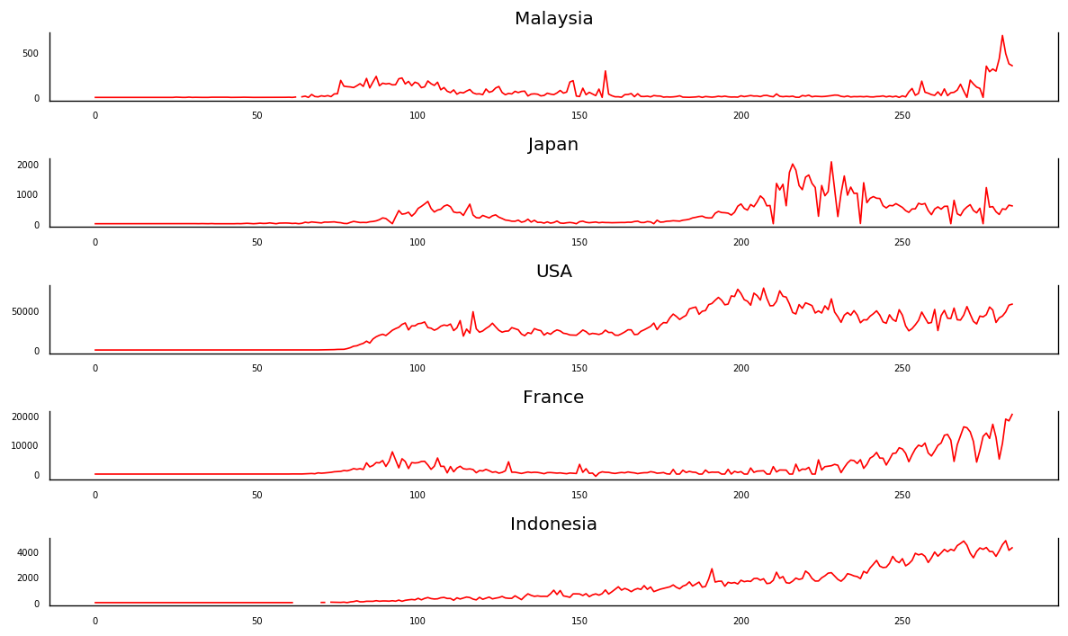
Curve of new confirmed positive covid_19 daily

Slide 8
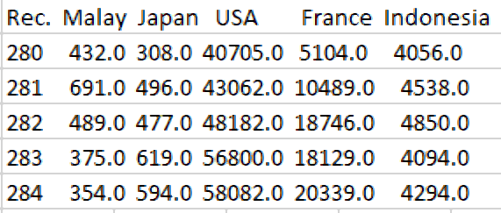
The 5 last observed values of confirmed covid_19

Slide 9
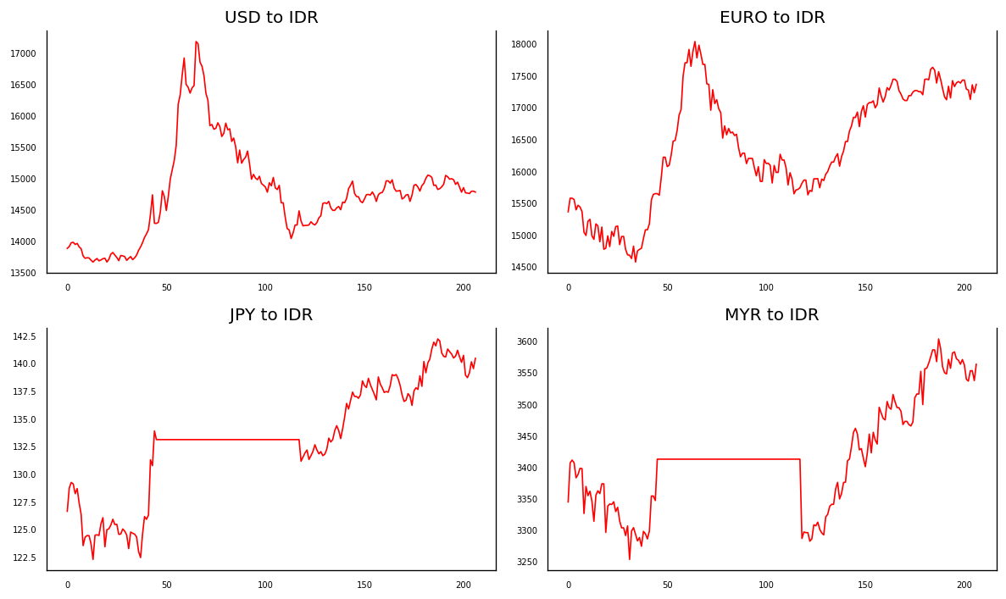
Plot of some currencies to IDR

Slide 10
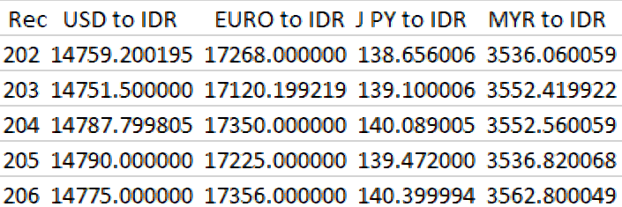
The 5 last observed values of exchange rate to IDR

Slide 11
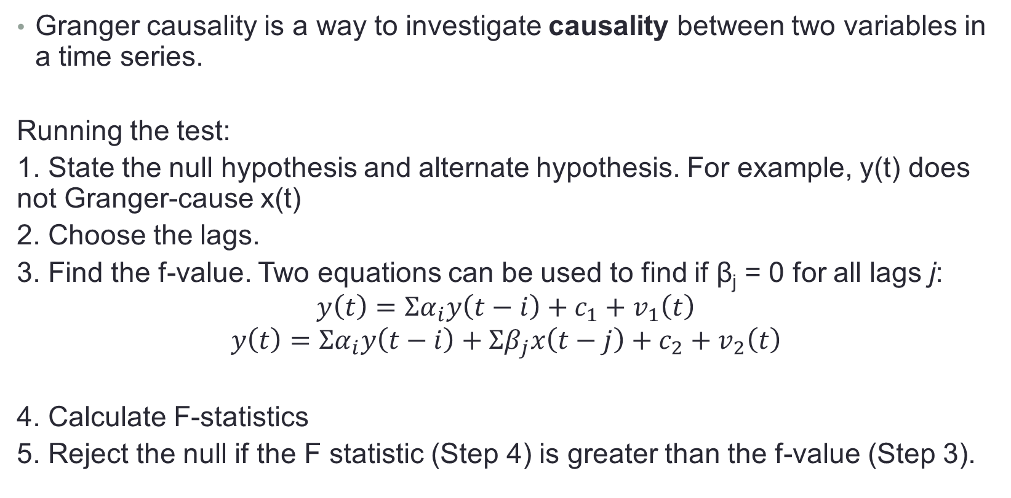
Granger Causality
Granger causality is a way to investigate causality between two variables in a time series.
Running the test:
1. State the null hypothesis and alternate hypothesis. For example, y(t) does not Granger-cause x(t)
2. Choose the lags.
3. Find the f-value. Two equations can be used to find if β_{j} = 0 for all lags j:
$$y\left(t\right)=Σα_{i}y\left(t−i\right)+c_{1}+v_{1}\left(t\right)$$
$$y\left(t\right)=Σα_{i}y\left(t−i\right)+Σβ_{j}x\left(t−j\right)+c_{2}+v_{2}\left(t\right)$$
4. Calculate F-statistics
5. Reject the null if the F statistic (Step 4) is greater than the f-value (Step 3).

Slide 12
Co-integration Test
Cointegration tests analyze non-stationary time series— processes that have variances and means that vary over time. Tests for cointegration identify stable, long-run relationships between sets of variables.
Three of the most popular tests are:
1. Engle–Granger
2. Phillips–Ouliaris
3. Johansen test
The null hypothesis:
H₀: No cointegration exists H₁: Cointegration exists

Slide 13
Cross Correlation Function (CCF)
CCF is need to determine the initial structure model on the multivariate time series analyses such as Vector Autoregressive (VAR) model
CCF can evaluated the relationship between 2 rime series.
The possible relationships are
A. two series are independently each to other
B. 2 series have one direction relationship
C. two series have bi-direction relationship

Slide 14
MODELING VAR, LSTM, RNN, CNN
Include model building, model testing, and use model for predicting of future values
Model building uses training data which some scenario in setting parameter and hyper-parameter model
use testing data to measure model performance on the MAPE, RMSE and R_squared criteria.

Slide 15
Thank you for the attention
Any suggestion ?

